Slide 1


Slide 2
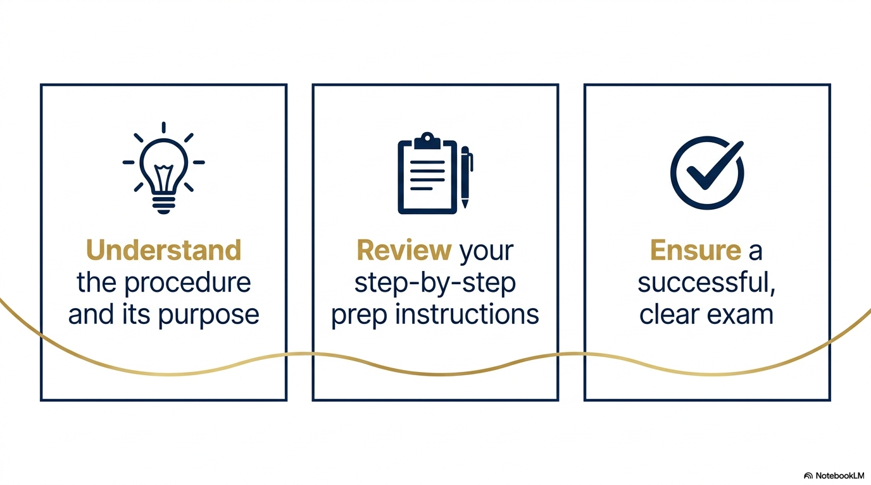

Slide 3
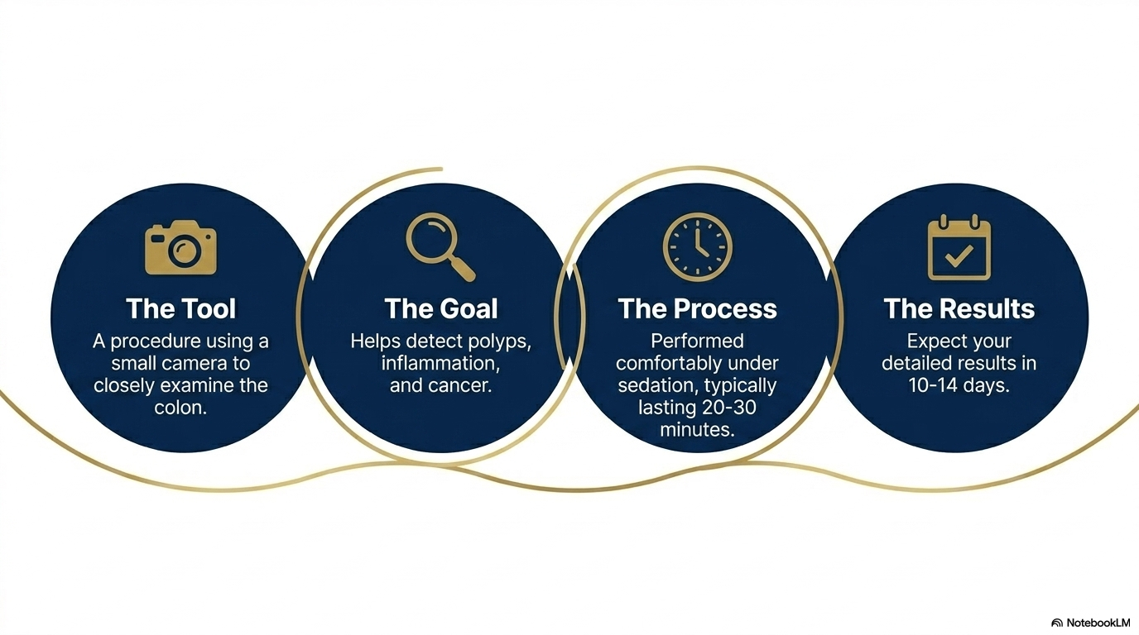

Slide 4
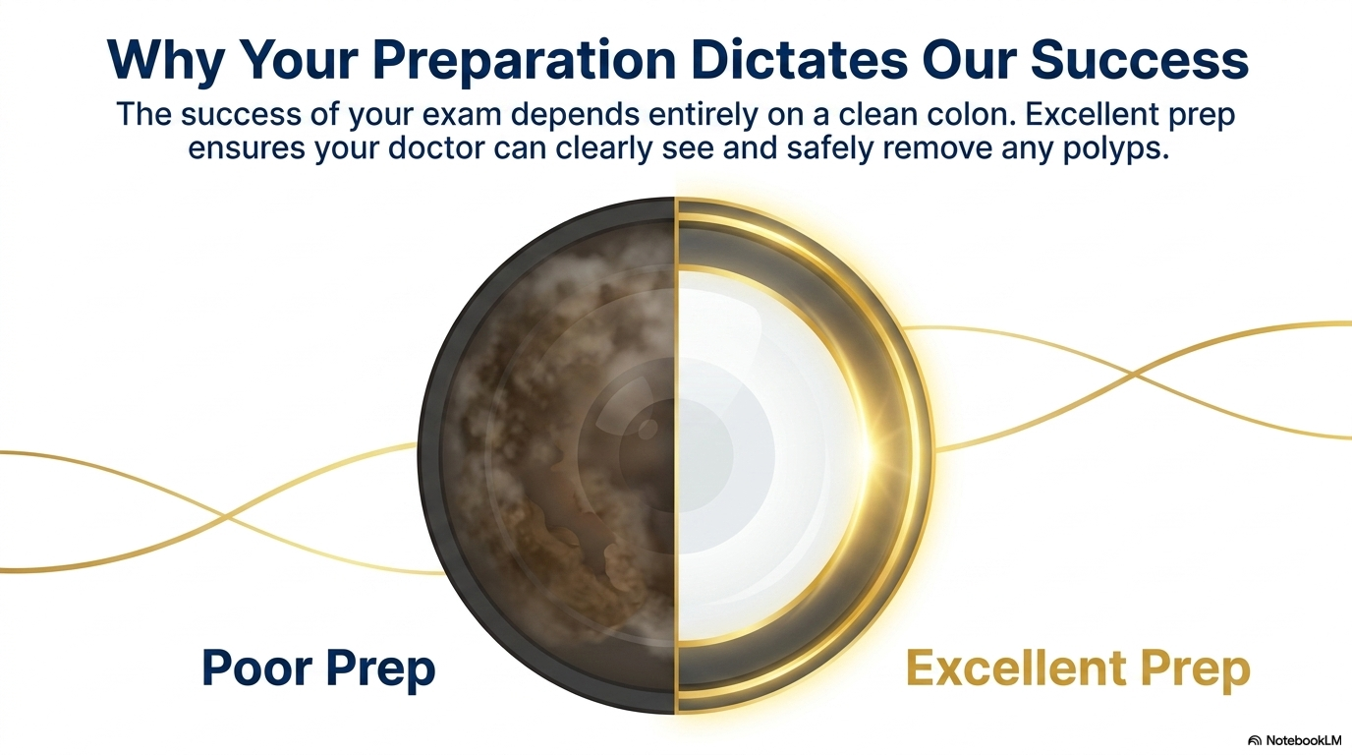

Slide 5
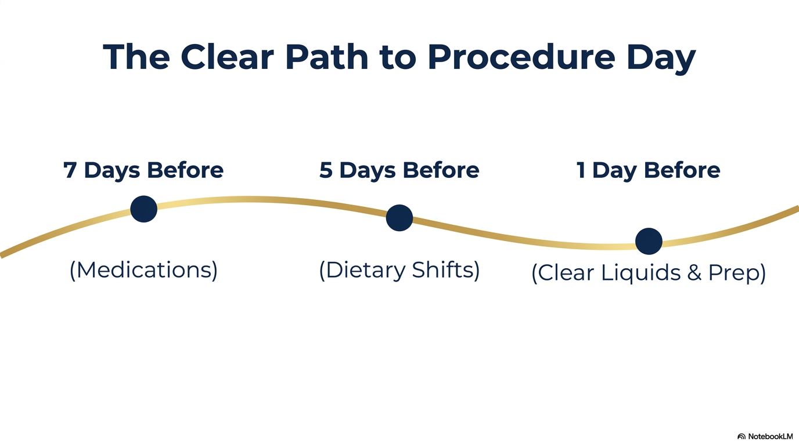

Slide 6
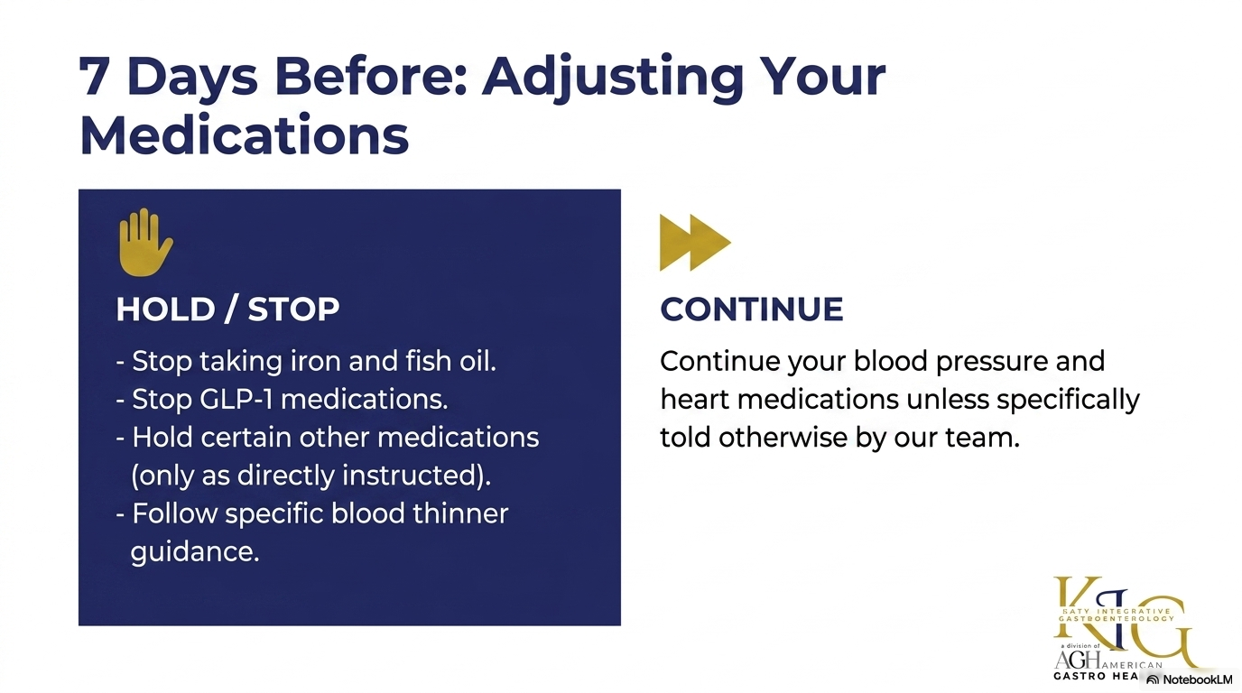

Slide 7
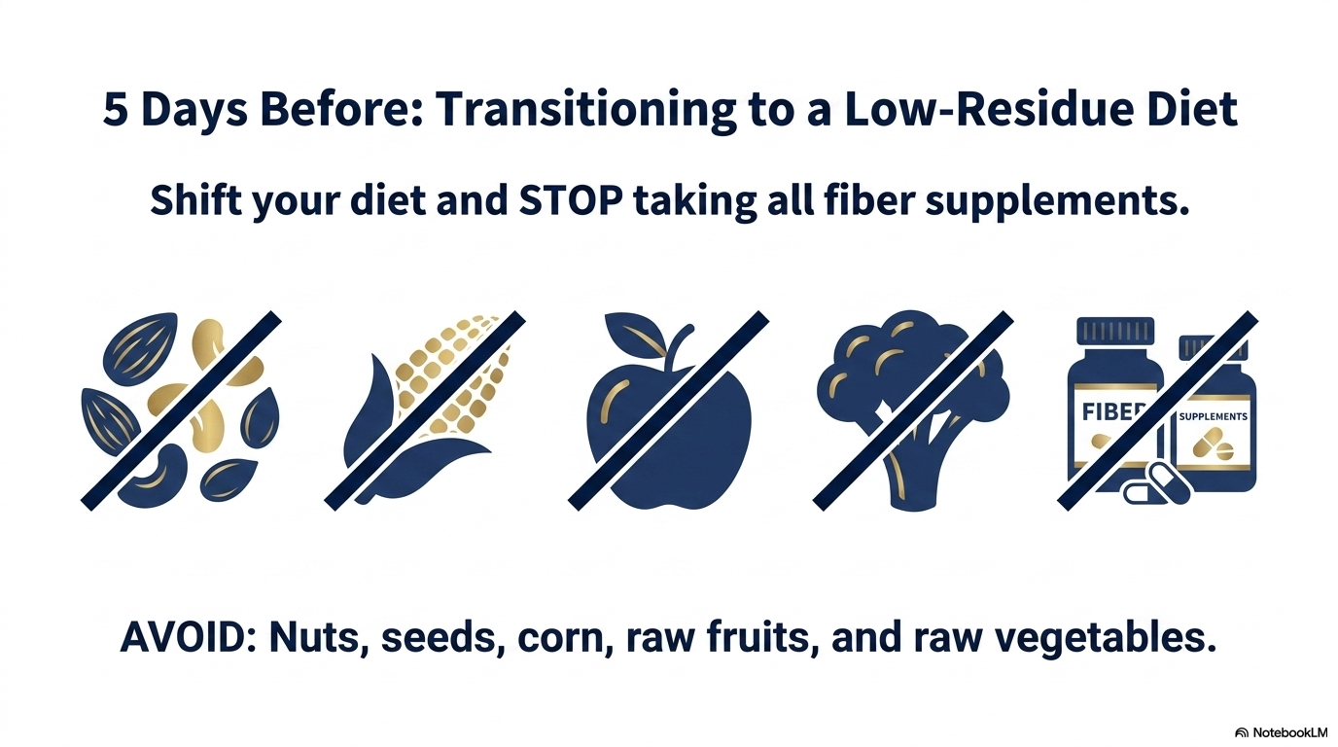

Slide 8
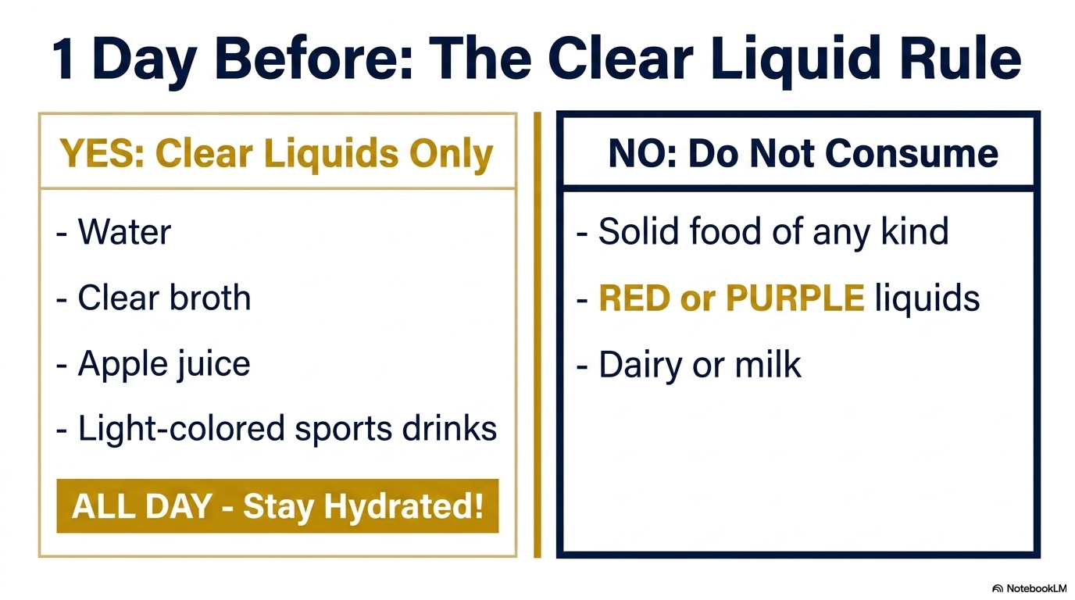

Slide 9
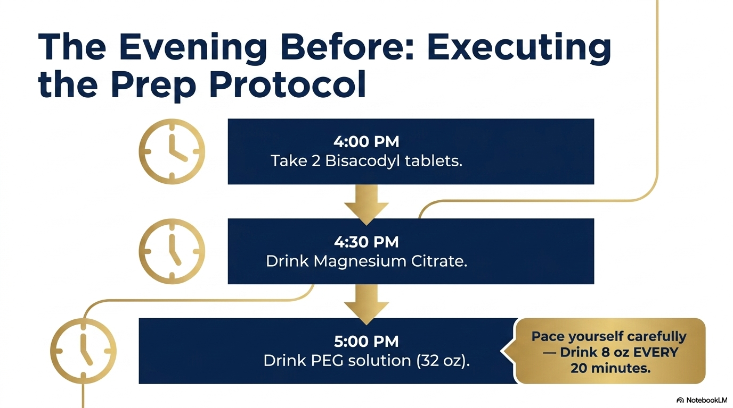

Slide 10
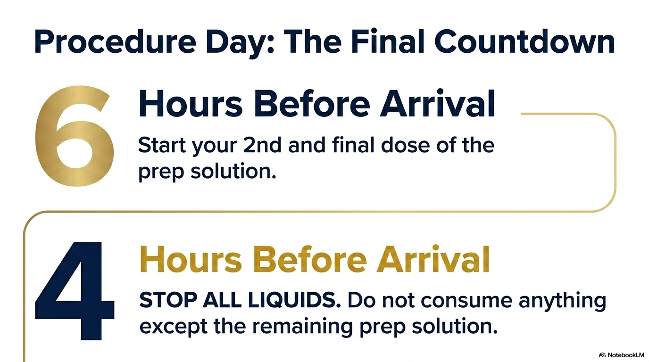
Stool should be clear/yellow (like urine).

Slide 11
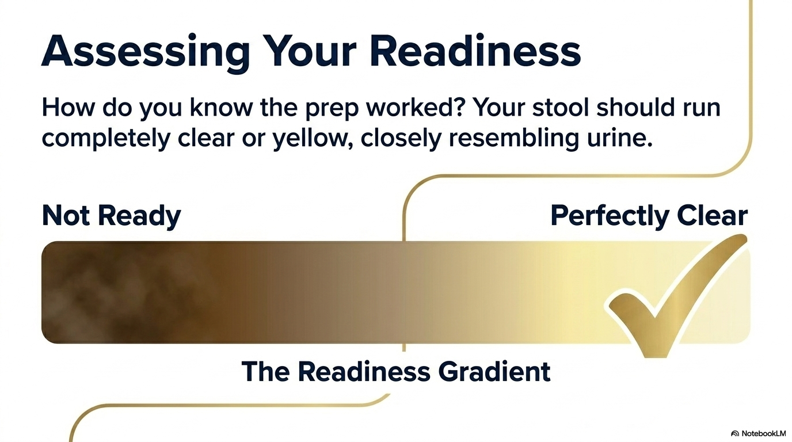

Slide 12
Common Mistakes to Avoid
X Not finishing the prep
X Eating solid food the day before
X Drinking liquids within 4 hours
X No driver arranged
These may ALL lead to cancellation or repeat procedure.

Slide 13
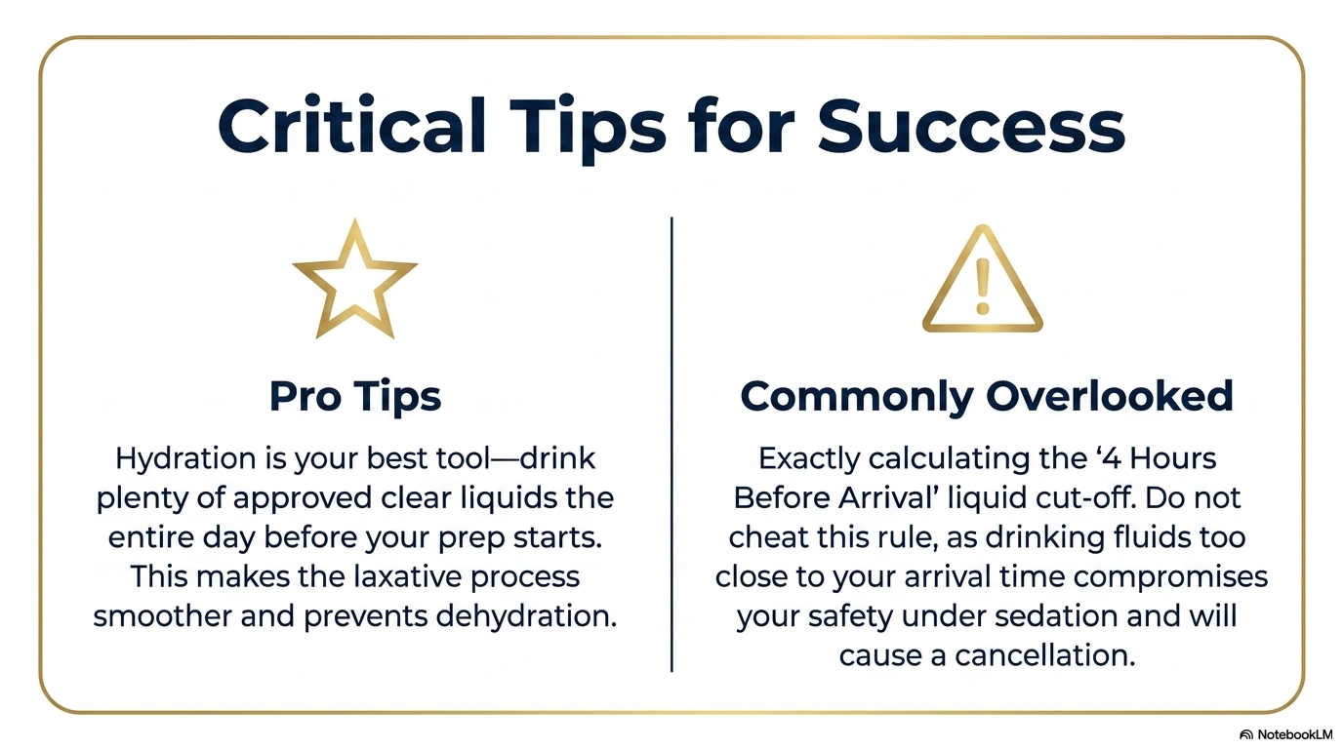

Slide 14
Patient Checklist (Take a Screenshot)
Arrange a driver for post procedure (required)
NO UBER OR TAXI allowed
pick up your prep kit (Recommended: EZ2GO)
Follow diet instructions exactly
Complete ALL prep solution
Stop liquids 4 hours before
Bring medications to appointment
medical questionnaire Form: Complete/submit to surgery center via text/email
confirm procedure date/time: Respond to surgery center via text/email

Slide 15
